Slide 1
CHAPTER 5 Predictive Control with constraints 5 Constraints in GPC with a T-filter
Anthony Rossiter

Slide 2
Background
So far the constraint code and development has focussed on a simple GPC algorithm.
However, it was noted in chapter 3 that one really needed to use a T-filter with CARIMA model based GPC to get satisfactory responses to measurement noise.
This video shows how the algebra and code can be modified to take account of a T-filter being used in the predictions.

Slide 3
GPC optimisation
GPC control law is defined by the following cost function, predictions and constraints.

Slide 4
Changes with a T-filter
The main change is the modification of the prediction equations (see chapter 2).
These appear in both the performance index and the constraints, thus both must be modified.

Slide 5
Performance index
This is written as follows:
Only change is how parameter a is computed at each sample.

Slide 6
Constraint inequalities
Constraints over the prediction horizon can be represented as:
Only change is in the output constraints part of the inequalities.

Slide 7
GPC optimisation with T-filter
GPC control law is defined by the following QP optimisation.

Slide 8
MATLAB code organisation
Define predictions
Define cost function parameters.
Define constraint equation parameters.
Set up a loop to iterate through control law computation and process update.
Control law requires a QP optimisation.
FOR NOW, ADVANCE INFORMATION ON THE TARGET IS OMITTED as are output constraints.
Main file is mpc_simulate_tfilt.m; input constraints only.
mpc_simulate_tfilt_outputconstraints.m also includes output constraints

Slide 9
video5_5_example1.m
Same example as video5_4_example1.m
Same responses. Constraint handling is clear.

Slide 10
video5_5_example2.m
Same as video5_4_example2.m
Although input seems to avoid constraints, this is because of nu being low and the predicted ‘violation’ being in the future, so with an extra d.o.f. this is then avoided.

Slide 11
video5_5_example3.m
Same as video5_4_example3.m
MIMO example, substantial interaction.

Slide 12
Add in output constraints
INCLUSION OF OUTPUT CONSTRANTS CAN CAUSE INFEASIBILITY - THIS CODE IS NOT DESIGNED TO BE ROBUST TO SUCH CASES AS WE WANT TO KEEP IT AS SIMPLE AND TRANSPARENT AS POSSIBLE!
mpc_simulate_tfiltoutputconstraints.m

Slide 13
video5_5_example4.m
SISO example, easy dynamics (1st order).
Add a sizeable disturbance around sample 20.
Cannot meet output constraints, so ignore for several samples.

Slide 14
video5_4_example5.m GPC video5_5_example5.m GPCT
Disturbance rejection is not so good with the T-filter and it fails to meet output constraint whereas GPC did.

Slide 15
video5_5_example6.m
SISO example with noise.
GPCT
Better noise rejection even during constraint handling.
GPC

Slide 16
video5_4_example7.m
MIMO example, substantial interaction. Nevertheless constraints are satisfied where possible and targets achieved.
GPCT has different disturbance rejection to GPC.

Slide 17
Summary
This video has shown how constraints can be incorporated into a GPC algorithm using a T-filter.
MATLAB code is provided to demonstrate the results.
The code is on the GPC folder.
No advance information on the target is assumed so as not to mix up different concepts.
The reader is reminded that the disturbance rejection and noise rejection responses are different to those without a T-filter, but, in the nominal case, tracking performance should be the same.

Slide 18



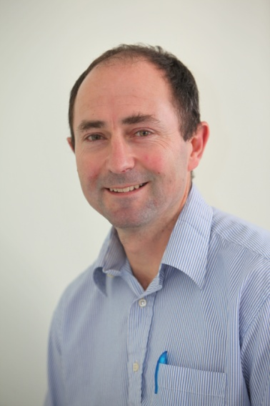
Anthony Rossiter
Department of Automatic Control and Systems Engineering
University of Sheffield
www.shef.ac.uk/acse
© 2014 University of Sheffield
This work is licensed under the Creative Commons Attribution 2.0 UK: England & Wales Licence. To view a copy of this licence, visit http://creativecommons.org/licenses/by/2.0/uk/ or send a letter to: Creative Commons, 171 Second Street, Suite 300, San Francisco, California 94105, USA.
It should be noted that some of the materials contained within this resource are subject to third party rights and any copyright notices must remain with these materials in the event of reuse or repurposing.
If there are third party images within the resource please do not remove or alter any of the copyright notices or website details shown below the image.
(Please list details of the third party rights contained within this work.
If you include your institutions logo on the cover please include reference to the fact that it is a trade mark and all copyright in that image is reserved.)

